Slide 1

New Web Framework
Introduction
Moses.Zhu
tech
2017/06/14

Slide 2
Agenda
简介
Portal功能介绍
使用

Slide 3
简介

Slide 4
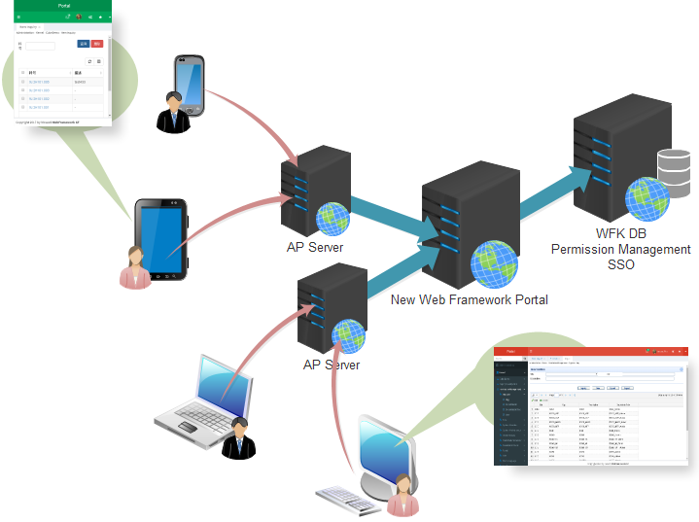
简介
基于原WFK权限模型的
新一代前端响应式框架

Slide 5
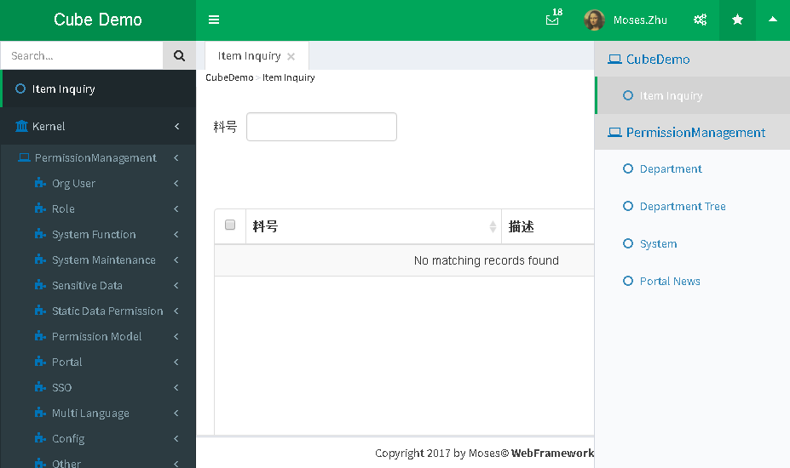
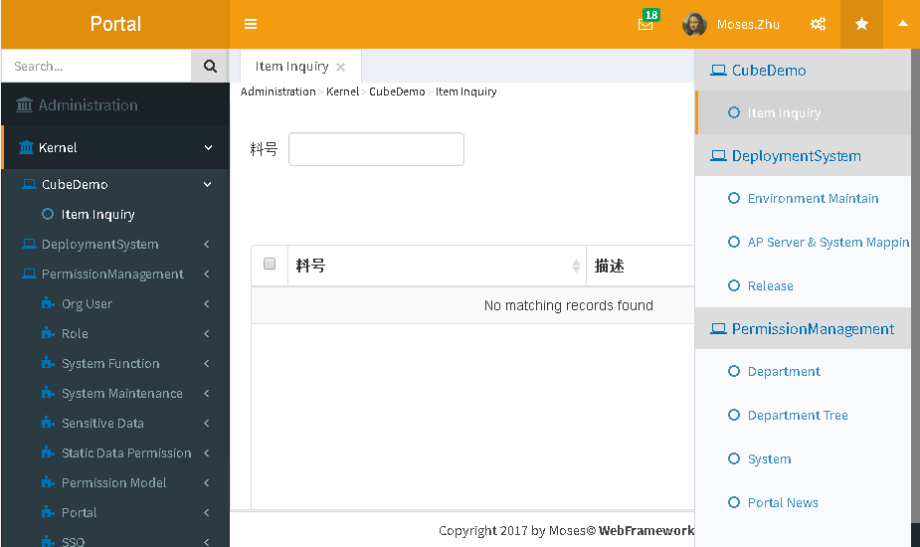
简介
单系统版本
Title
Menu
Bookmark
整合版本

Slide 6
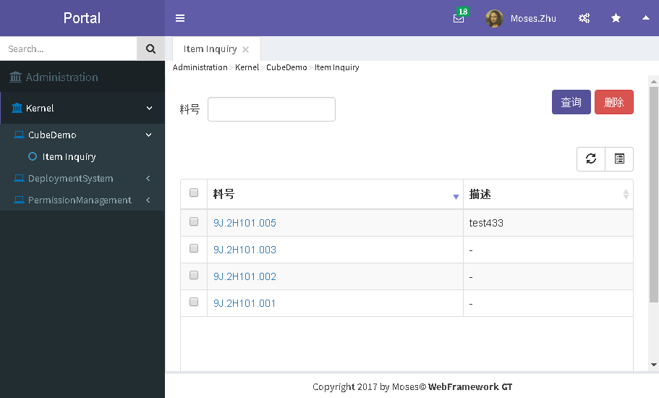
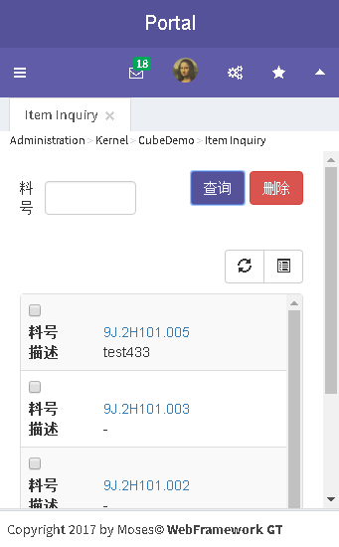
简介
Header Style
内容区自适应
Menu sidebar自适应
响应式UI

Slide 7
Portal功能介绍

Slide 8
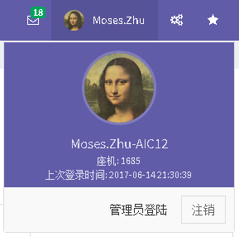
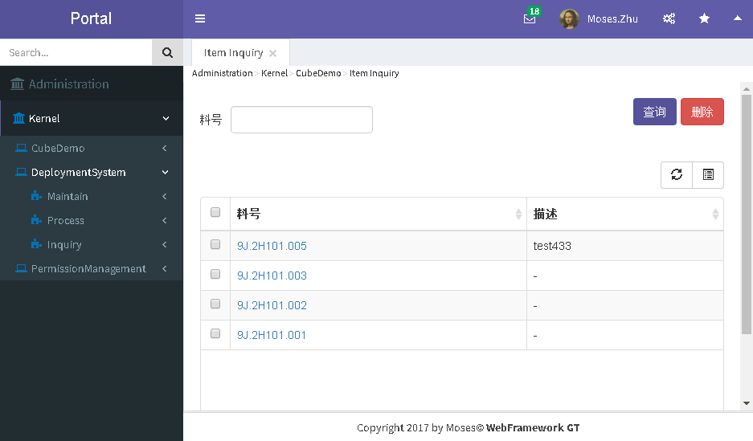
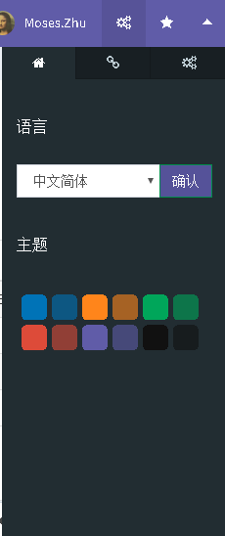
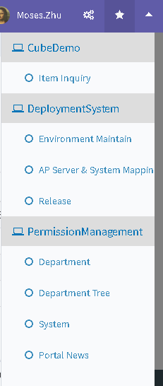
Portal区域
Header Title
Header Toolbar
Breadcrumb
User Info Panel
Menu Sidebar
Option Sidebar
Bookmark Sidebar
Footer

Slide 9
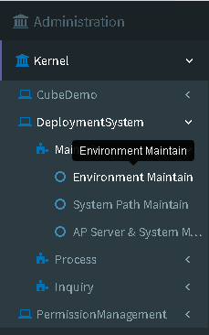
Menu
Product
Domain
System
Function
Tooltip
Sub Function
Sub Function
Sub Function

Slide 10
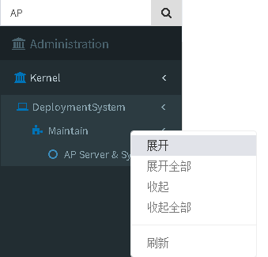
Menu
Search Menu: Click Search Button or key Enter
Right Click: Show Menu Context menu

Slide 11
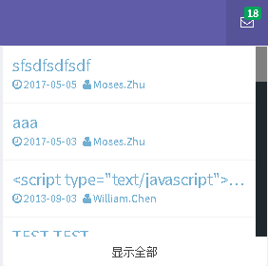
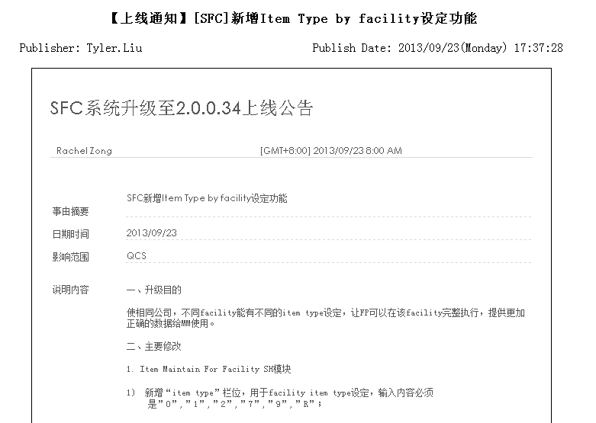
Message Panel
Badge
Subject
Click to open a new window showed message detail
Send User & Date
Click to toggle showing All message or New message

Slide 12
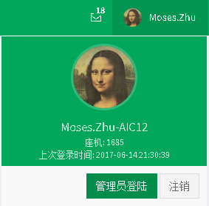
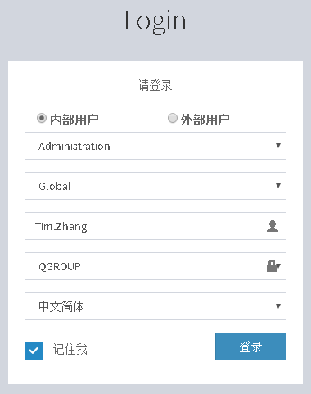
User Info Panel
Avatar
User Name / Department / Ext
Admin simulate login not need to enter password
Admin login button will be show if authorized
Click to logout

Slide 13
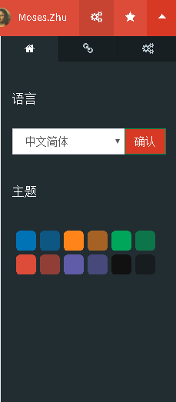
Skin & Language Setting Panel
Toggle Option sidebar
Skin & Language tab
Change language, all forms will be change
Change skin, all forms will be change

Slide 14
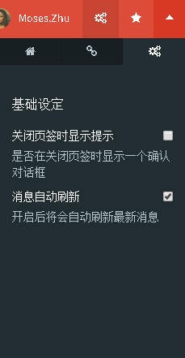
General Setting Panel
Toggle Option sidebar
General Setting tab
All setting change will effect immediately

Slide 15
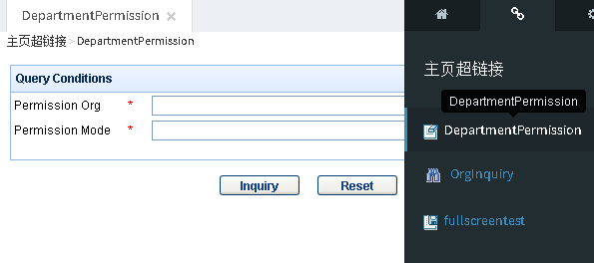
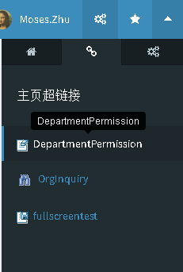
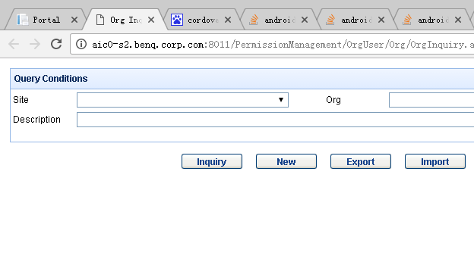
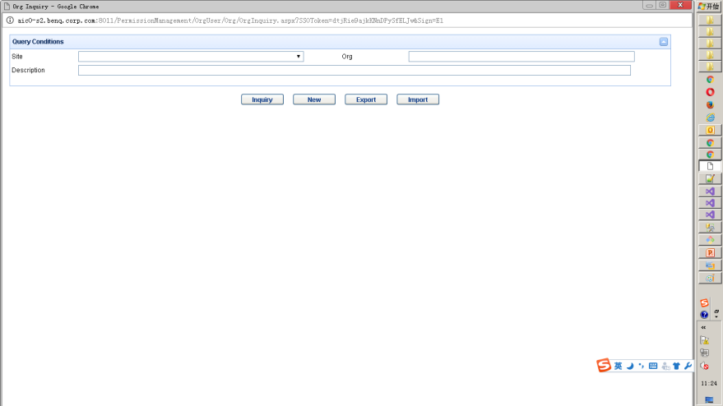
Portal Link Panel
Tab
Tooltip
Window
Full Screen

Slide 16
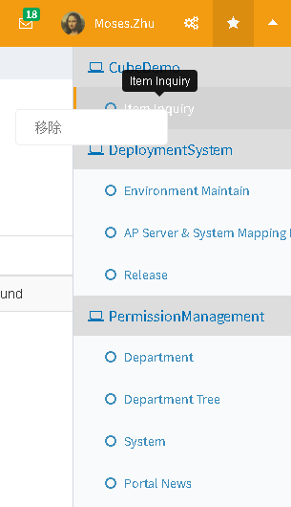
Bookmark Panel
Toggle Bookmark sidebar
Tooltip
Right Click: Show Menu Context menu, remove bookmark
System the bookmark belong to
Bookmark

Slide 17
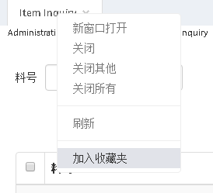
Bookmark Panel
To add a function to Bookmark, Right click this function tab

Slide 18
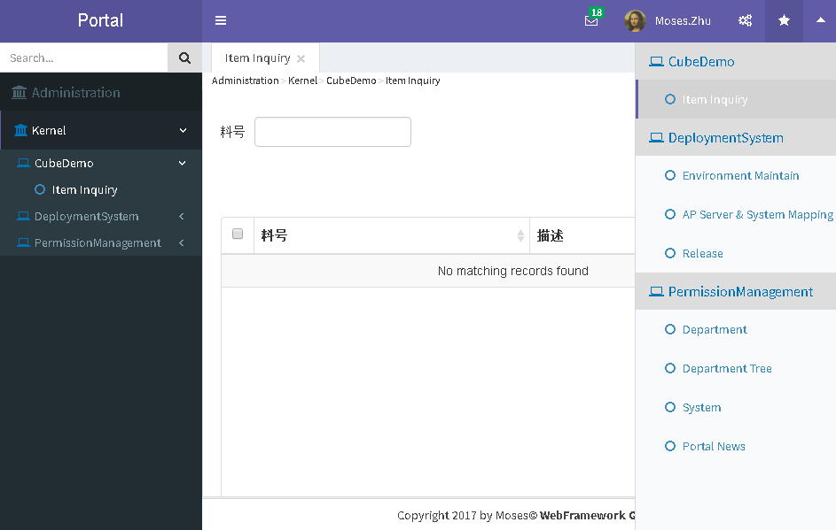

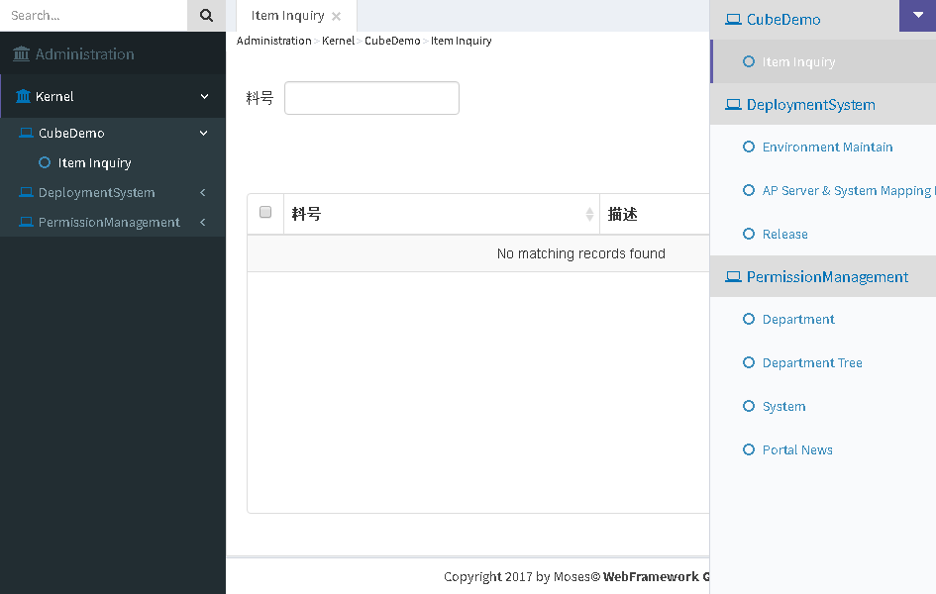

Header Visible Toggle
Click to hide Header
Click to show Header

Slide 19
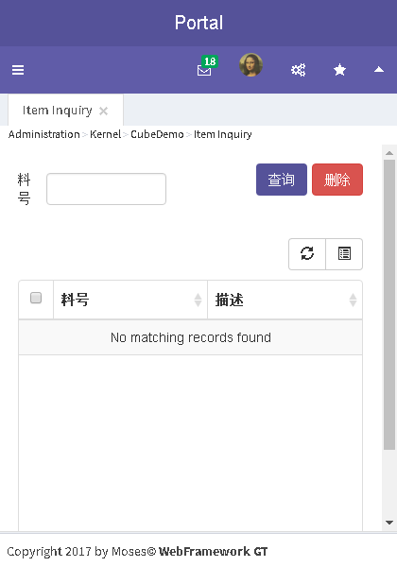
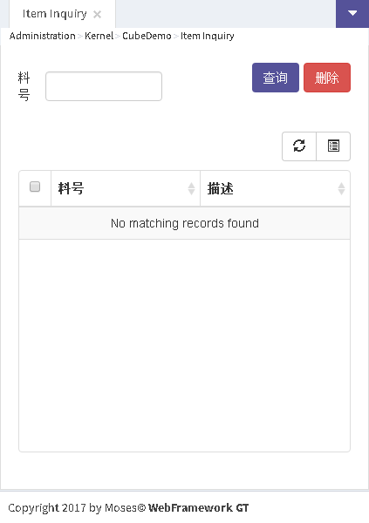
Header Visible Toggle
Click to hide Header
Click to show Header

Slide 20
Main Content

Slide 21
使用组件

Slide 22
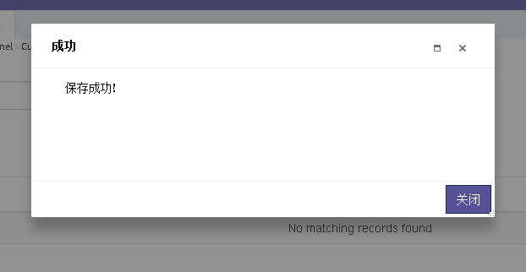
对话框
Title
Drag able
Content
Resizable
Mask

Slide 23
呼叫Service

Slide 24
Debug

Slide 25


